Slide 1
CELL INJURY - APOPTOSIS
DR.GOPIKA.R.S
Prof& Head
Dept.of Pathology &Microbiology
SKHMC

Slide 2
APOPTOSIS
programmed cell death
apoptosis - "falling off"
is a pathway of cell death that is induced by a tightly regulated suicide program in which cells destined to die activate enzymes capable of degrading the cells own nuclear DNA and nuclear and cytoplasmic proteins.

Slide 3
Causes of Apoptosis
serves to eliminate potentially harmful cells.
cells that have outlived their usefulness.
the irrepairably damaged cell is eliminated.

Slide 4
Mechanisms of Apoptosis
an active enzymatic process in which nucleoproteins are broken down and then the cell is fragmented.
The fundamental event - activation of enzymes called caspases

Slide 5
Important enzymes of apoptosis
Caspases
Ca 2+ dependent endonucleases
Mg 2+ dependent endonucleases
Regulation of apoptosis - mediated by a number of genes and their products
bcl-2 gene inhibits apoptosis
bax genes facilitates apoptosis
p 53 facilitates apoptosis by inhibiting bcl 2 and promoting bax genes.

Slide 6
Mechanism of Apoptosis
Two distinct pathways converge on caspase activation.
- mitochondrial pathway
- death receptor pathway.

Slide 7
Mitochondrial pathway
Intrinsic pathway

Slide 8
when cells are deprived of GF and trophic hormones, or exposed to agents that damage DNA, accumulation of misfolded proteins
activate
a group of sensors Bcl-2 family
activate
two pro-apoptotic members - Bax and Bak - dimerize,
insert into mit.mem, pore formation
cytochrome c and other mitochondrial proteins
activates
caspase-9, block the activities of caspase antagonists
activation
caspase cascade
leading to nuclear fragmentation

Slide 9
The Death Receptor (Extrinsic) pathway
Fas ligand/receptor interactions
Prototypic death receptors Fas (CD95) - type-II transmembrane protein that belongs to the TNF family.
activated T lymphocytes. Express Fas-ligand (FasL) a membrane protein

Slide 10
The Death Receptor (Extrinsic) pathway
Fas ligand/receptor interactions
bind to adapter proteins
which in turn bind caspase-8.
activation
initiating the caspase cascade.

Slide 11
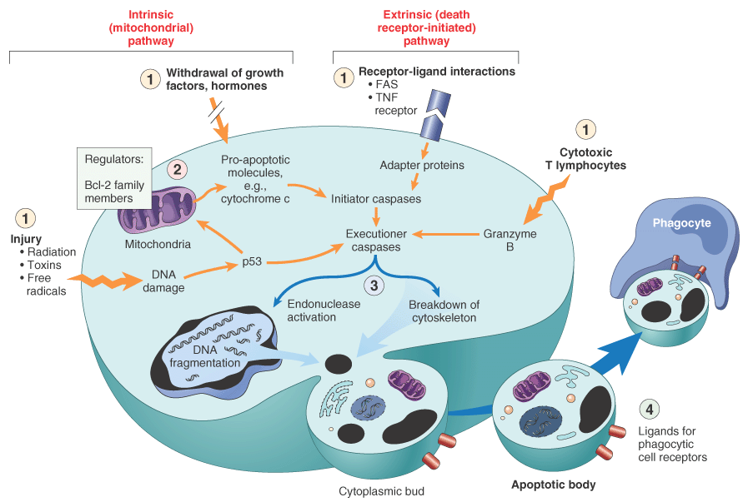
Mechanisms of apoptosis.

Slide 12
Morphology of Apoptosis
On histology apoptosis involves single cells or small clusters of cells.
The apoptotic cell appears as a round or oval mass of intensely eosinophilic cytoplasm with dense nucleus.
There is no inflammation

Slide 13
Morphology
Nuclei – pyknosis followed by karyorrhexis
fragmentation of DNA into nucleosome.
The cells rapidly shrink, form cytoplasmic buds, and fragment into apoptotic bodies composed of membrane-bound vesicles of cytosol and organelles

